Slide 1
Craft Beers and Breweries in the United States
Zwei Group: Elisabet Zidow, Jonathan Franks, Shanqing Gu
Introduction
Each State contains its own unique drinking culture. Our Zwei Analytics attempts to review the available 2410 craft beers and 558 breweries in the United States in order to explore this culture.
There are two common beer measurements: Alcohol by Volume (ABV) and International Bitterness Unit (IBU). Rather than telling us how much alcohol there is like ABV, IBU measures the bitterness from hops in a beer on a scale of 0 to 100.
Here, we provide the answers to these main questions and help you make your own own judgements about each states drinking culture :
How many breweries are present in each state?
What are the median ABV and IBU values for each state?
Which state has the maximum ABV or IBU beer?
Is there an relationship between the ABV and IBU?

Slide 2
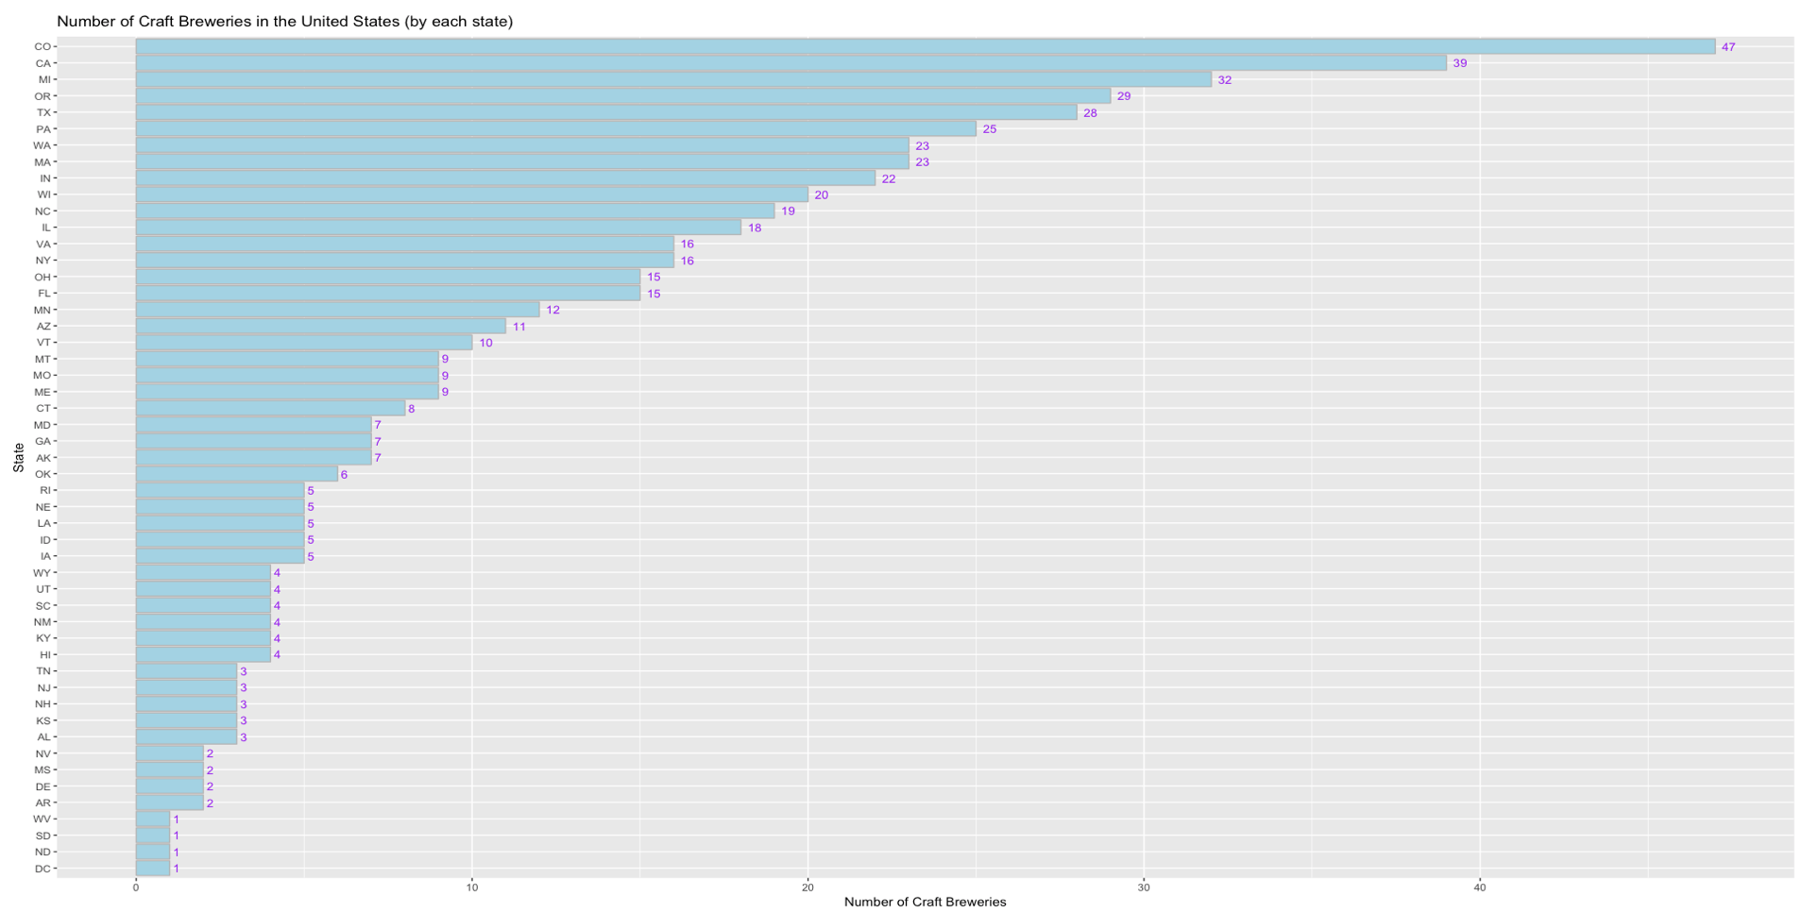
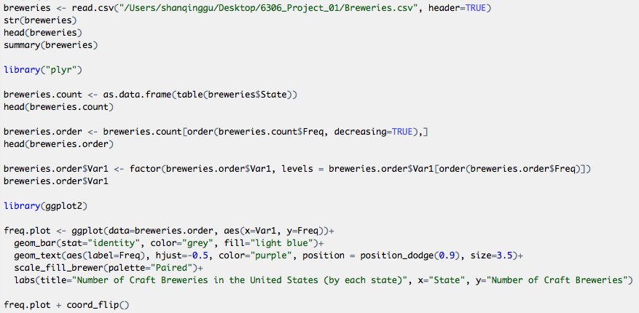
Q1: How many breweries are present in each state?

Slide 3
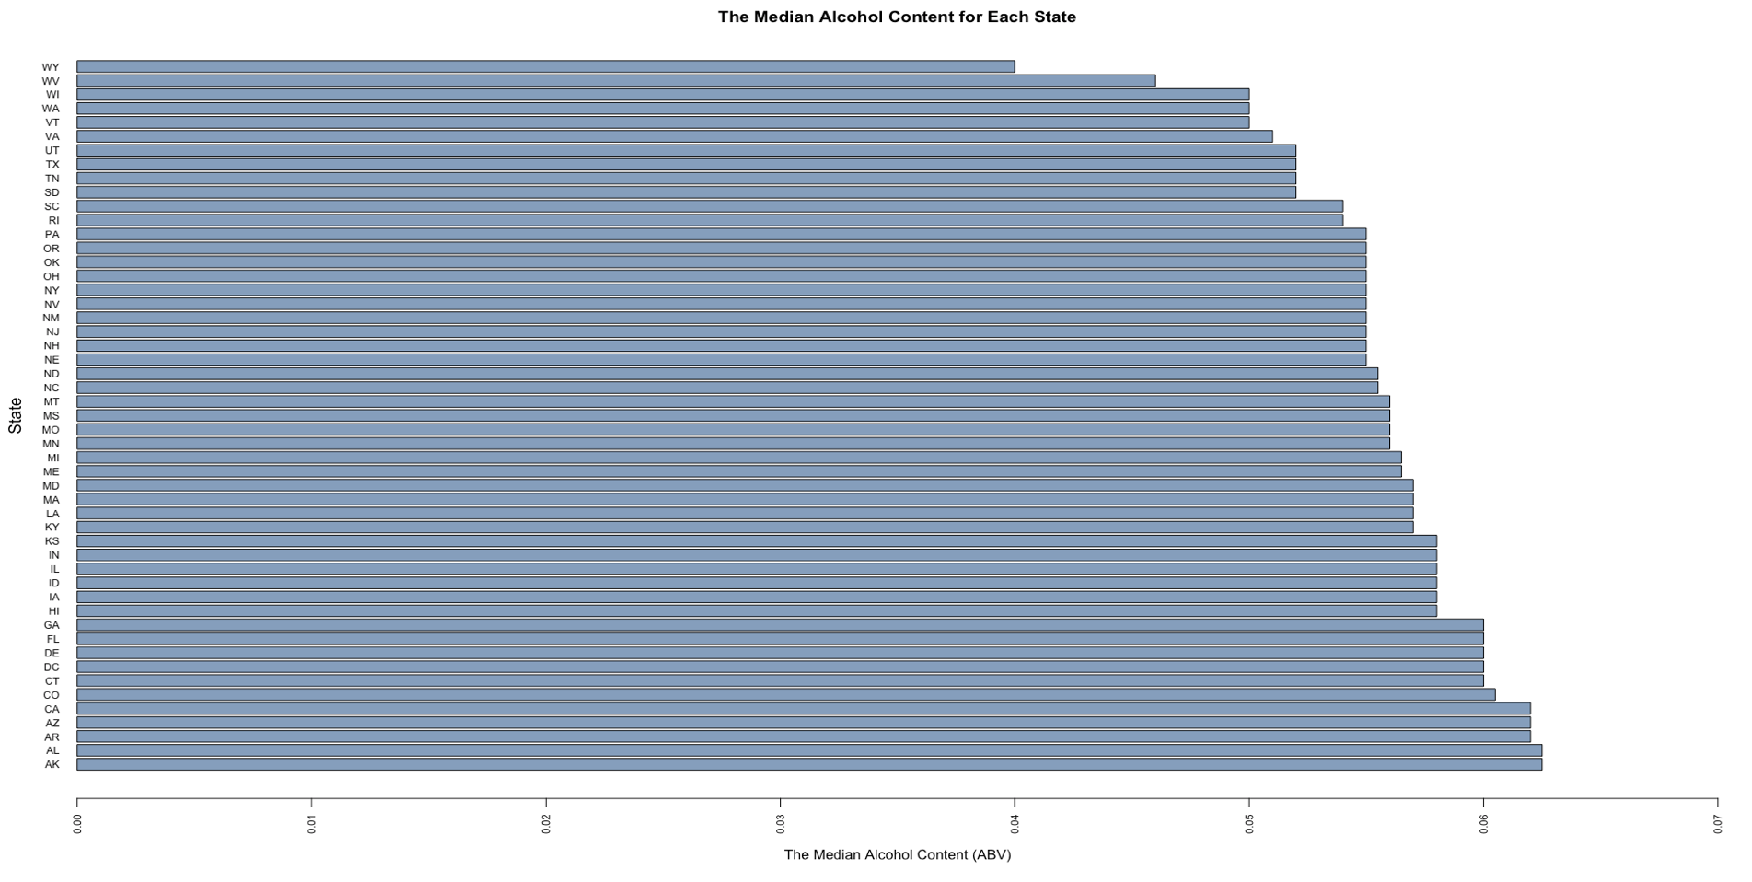
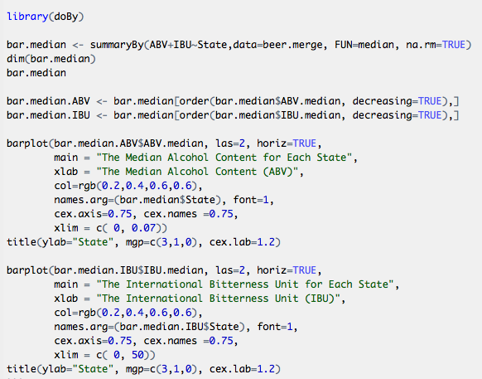
Q2: What are the median ABV values for each state?

Slide 4
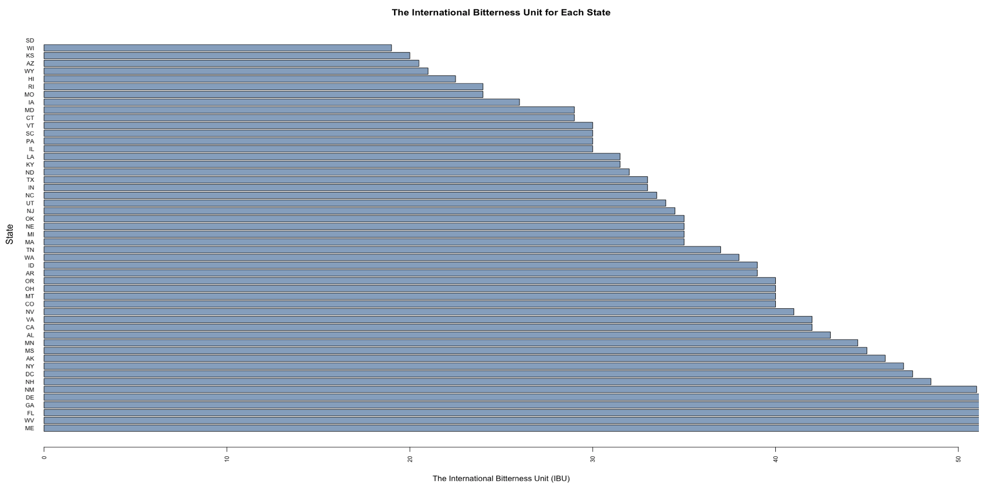
Q2: What are the median IBU values for each state?

Slide 5
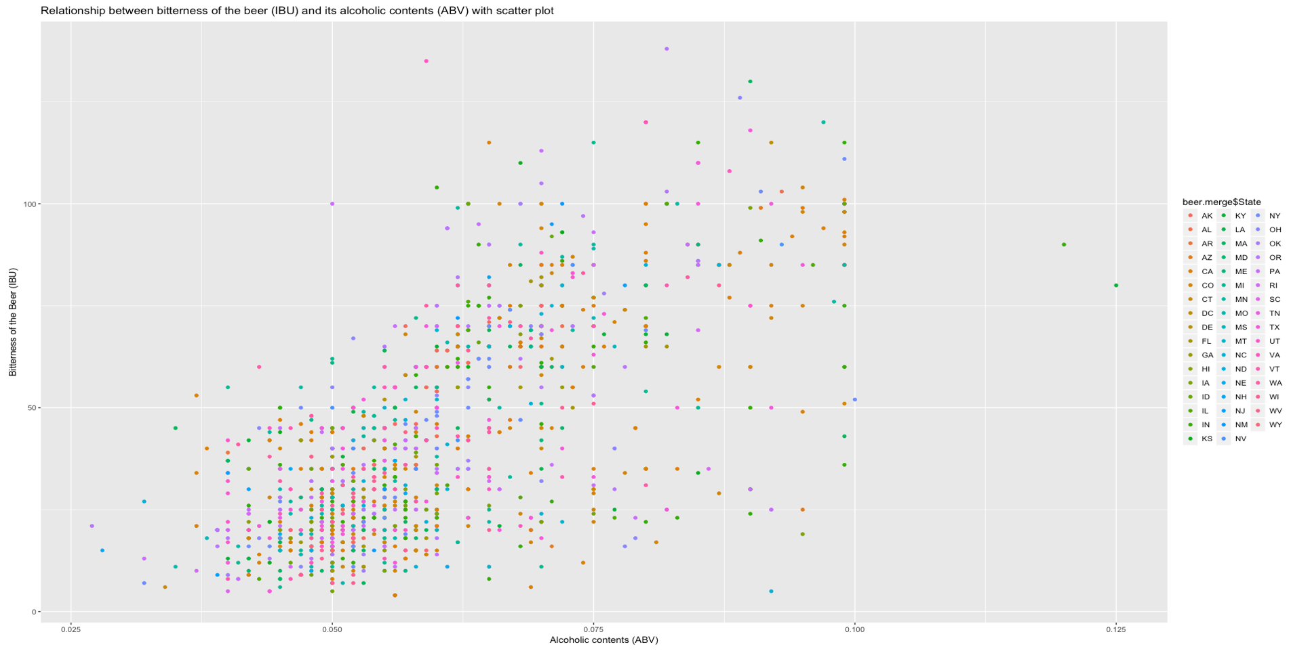
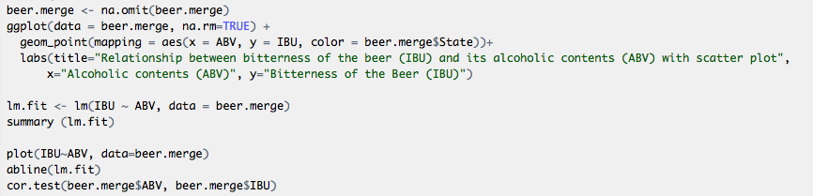
Q4 Is there an relationship between the ABV and IBU?

Slide 6
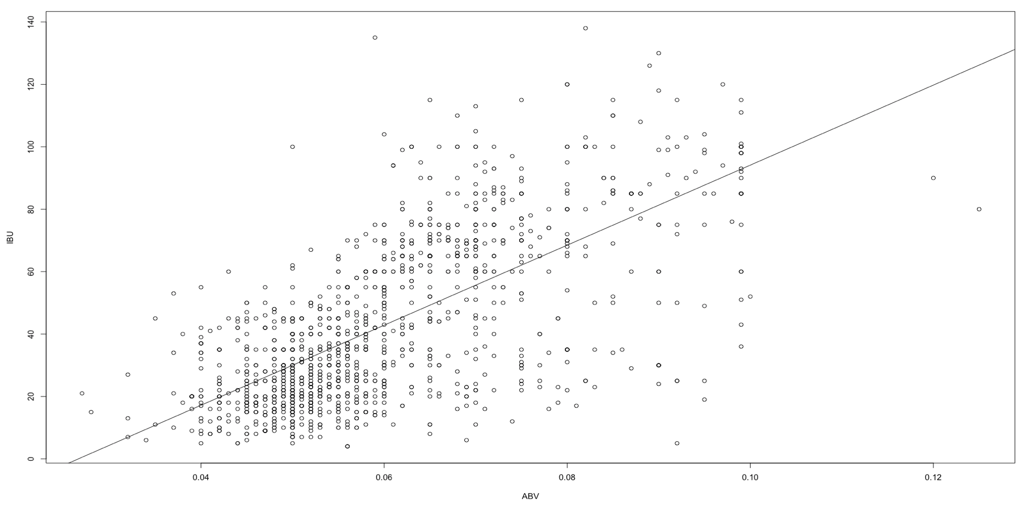
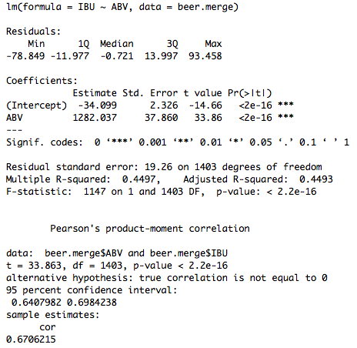
Q4: Is there an relationship between the ABV and IBU?

